Slide 1

Content: aka.ms/mkedevdays
#Azuredevdays

Slide 2
Azure Dev Days – Hands On Labs

Slide 3

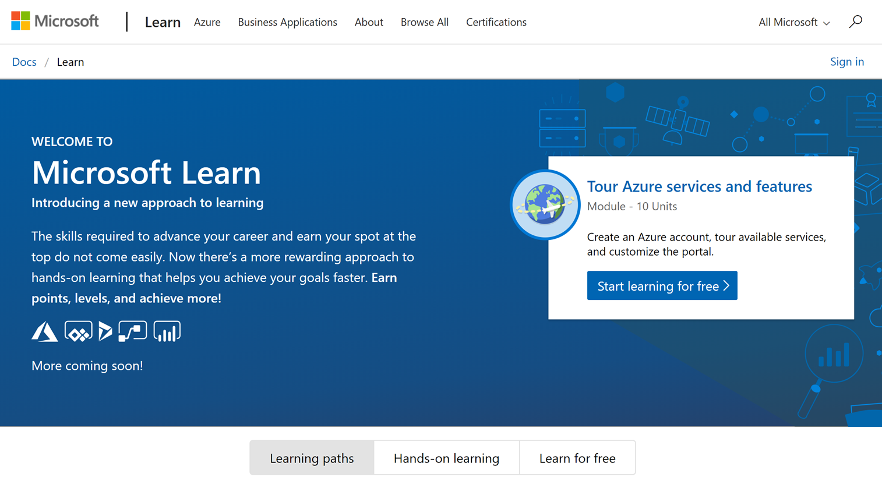
Microsoft Learn
Build your skills fast with free, interactive tutorials at Microsoft Learn, a new training experience for technical users.
Step-by-step training to fit your schedule
Interactive coding environments for hands-on experience
Earn achievements and recognition for your Azure skills
We provide free Azure sandboxes, free virtual machines, etc. so there is nothing to setup ahead of time
http://www.Microsoft.com/Learn
➔
Notes:
Introducing Microsoft Learn – the Best place to start learning Microsoft technologies – Free!
Quickly build skills: interactive, step-by-step bite-size tutorials
Learn by doing: browser-based interactive coding environments for hands-on experience. Free fixed-time access to create and manage Azure resources - no credit card required.
Earn recognition: Track progress, check knowledge, and validate deployments to earn points, levels, achievements, and trophies
Learning aligned to new role-based certifications: easier for you to prepare for certification and be recognized as a leader in Microsoft technologies
Multiple modes of learning: learn in way best for you. select from free self-paced quick tutorials and hands-on learning, to structured online courses free from Pluralsight and instructor led classes from learning partners. Get started by selecting a Learning Path that is closest to your role, e.g. Business Analyst , Azure Developer , Azure Solution Architect . Regarding the individual modules: You can start with the basics such as Tour Azure services and features or go deep with something like Create serverless applications.

Slide 4
Azure Learning Paths by Azure Service - Compute
Master core concepts at your speed and on your schedule. Whether you've got 15 minutes or an hour, you can develop practical skills through interactive training.
Azure Fundamentals - Interested in the cloud, but aren't quite sure what it can do for you? This learning path is the place to start. Learn the benefits of cloud computing, features in Azure that will save you time and money, basic strategies for transitioning to the cloud and more.
App Service - Web apps in Azure allow you to publish and manage your website easily without having to work with the underlying servers, storage, or network assets. Instead, you can focus on your website features and rely on the robust Azure platform to provide secure access to your site.
Containers - Azure Container Instances are the quickest and easiest way to run containers in Azure. This learning path will teach you how to create and manage your containers, and how ACI can be used to provide elastic scale for Kubernetes.
Serverless - Azure Functions enable the creation of event driven, compute-on-demand systems that can be triggered by various external events. Learn how to leverage functions to execute server-side logic and build serverless architectures.

Slide 5
Azure Learning Paths by Azure Service - Data
Master core concepts at your speed and on your schedule. Whether you've got 15 minutes or an hour, you can develop practical skills through interactive training.
Store data in Azure - Azure provides a variety of ways to store data: unstructured, archival, relational, and more. Learn the basics of storage management in Azure, how to create a Storage Account, and how to choose the right model for the data you want to store in the cloud.
Cosmos DB - Learn how to distribute your data globally with Azure Cosmos DB. In this module, you will:
Learn about the benefits of writing and replicating data to multiple regions around the world
Change the read and write priorities for the regions in which your data is located
Change the consistency setting for your database
Using Cosmos DB with other services – Select from a number of modules that use Cosmos DB to provide highly scalable solutions.
SQL Databases - Azure supports several popular SQL-based database solutions including SQL Server, PostgreSQL, and MySQL. Learn how to use these enterprise data solutions in Azure to store and retrieve your app's data in the cloud.
Using SQL Databases with other services – Select from a number of modules that use SQL as part of the solution.

Slide 6
Azure Learning Paths by Azure Service – Cognitive Services
Master core concepts at your speed and on your schedule. Whether you've got 15 minutes or an hour, you can develop practical skills through interactive training.
Process images with the Computer Vision service - Use the Computer Vision API to analyze images for insights, extract text from images, and generate high-quality thumbnails. In this module, you will:
Create a Cognitive Services account.
Get information about the visual content found in an image.
Generate a thumbnail of an image.
Detect and extract printed text from an image.
Detect and extract handwritten text from an image.
Write internet-connected Windows apps - Bring the intelligence of the internet to your Windows 10 apps. In this module, you will:
Use Microsoft Azure's Cognitive Services platform to find images based on text descriptions
Write an app that connects to NASA's 'Astronomy Picture of the Day' service to download a picture

Slide 7
Azure Learning Paths by Azure Service – Other Services
Master core concepts at your speed and on your schedule. Whether you've got 15 minutes or an hour, you can develop practical skills through interactive training.
DevOps - In this module, we'll explore DevOps and learn how to get started with Azure DevOps. In this module, you will:
Learn how Azure DevOps can provide a streamlined DevOps pipeline
Sign up for a free Azure DevOps account
Create a new project in Azure DevOps
Key Vault - Your application requires service passwords, connection strings, and other secret configuration values to do its job. Storing and handling secret values is risky, and every usage introduces the possibility of leakage. Azure Key Vault, in combination with managed identities for Azure resources, enables your Azure web app to access secret configuration values easily and securely without needing to store any secrets in your source control or configuration.
Azure Active Directory – Review topics that include how to use Azure Monitor
Monitor - (Application Insights & Log Analytics) – Review topics that include how to use Azure Monitor

Slide 8
Azure Learning Paths by Role
Up your game with a learning path tailored to today's developer and technology masterminds and designed to prepare you for industry-recognized Microsoft certifications.
Solution Architect
Developer
Administrator

Slide 9
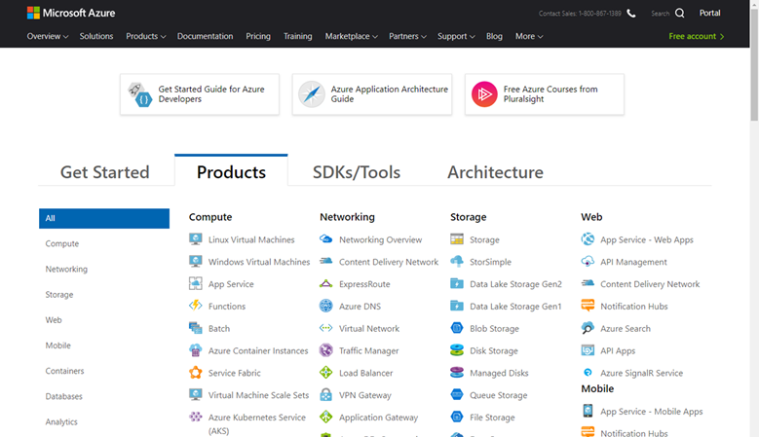
Documentation - Azure Services Index
Use this end-to-end index to learn about all the services available in Azure
Use this end-to-end feature index to learn about all Azure services.
If you only save one Favorite in your browser related to Azure, this is the link to save as a favorite!
Most topics contain Quickstarts and Tutorials allowing you to gain hands-on experience quickly
https://docs.microsoft.com/en-us/Azure/#pivot=products&panel=all
➔

Slide 10
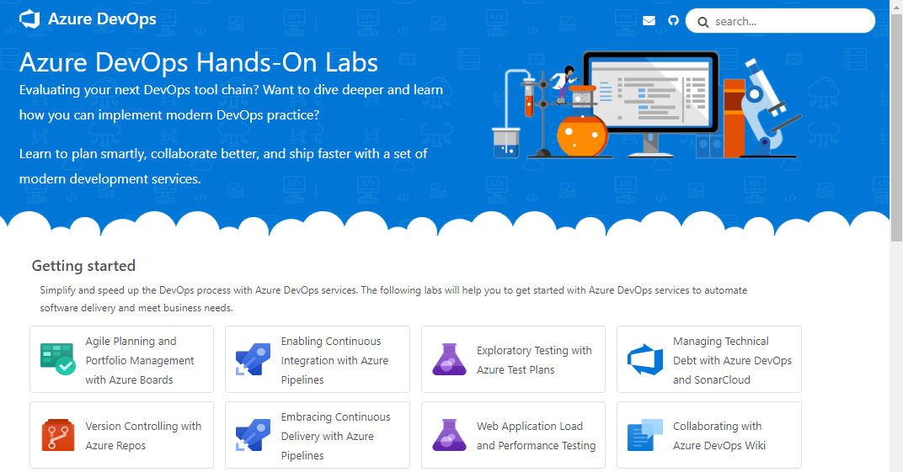
Azure DevOps Hands-On Labs
Learn to plan smartly, collaborate better, and ship faster with a set of modern development services.
Get Hands On Experience with Azure DevOps Services – Learn how you can plan better, code together and ship faster with Azure DevOps Services.
Getting started - These labs will help you to get started with Azure DevOps services to automate software delivery and meet business needs.
Deep Dive into Azure DevOps - Learn how to integrate with popular OSS and 3rd party tools and services. Use the tools and languages you know.
https://www.AzureDevOpsLabs.com
➔

Slide 11
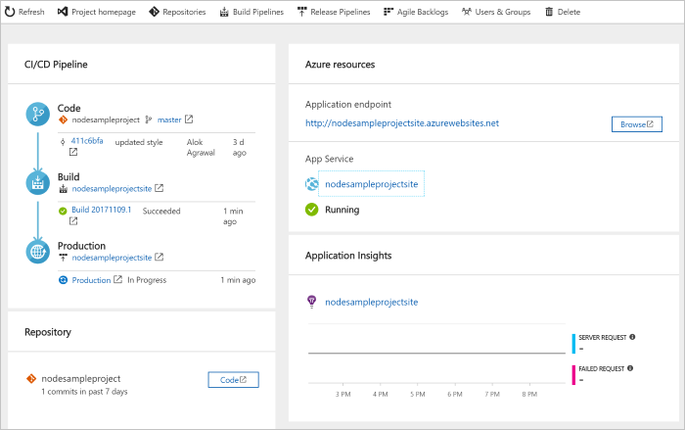
DevOps Pipelines in Minutes
Azure DevOps Projects
Create a full DevOps pipeline with 3 easy steps from the Azure Portal
Start with a Git repo and any source language
Web apps, Kubernates, soon VMs and more.
Customize, extend and scale when needed.
https://docs.microsoft.com/en-us/azure/devops-project/
➔
Notes:
Moving from the developer environment, Azure also makes deploying, or integrating existing, DevOps pipelines as fast as possible
Azure DevOps Projects is the quickest way to get started with DevOps on Azure for people who know about DevOps but are just starting or want a quick way to create a basic pipeline to play with or build upon.
DevOps projects creates a basic, complete CI/CD pipeline in Azure which can later be extended and customized outside in Azure Pipelines
Although DevOps Projects builds a DevOps pipeline on Azure it allows for any easy “Getting started” experience with Azure Pipelines which can then be applied to hybrid and on-prem scenarios with Azure Pipelines which can target any platform or with Azure DevOps Server which can be installed on prem.

Slide 12
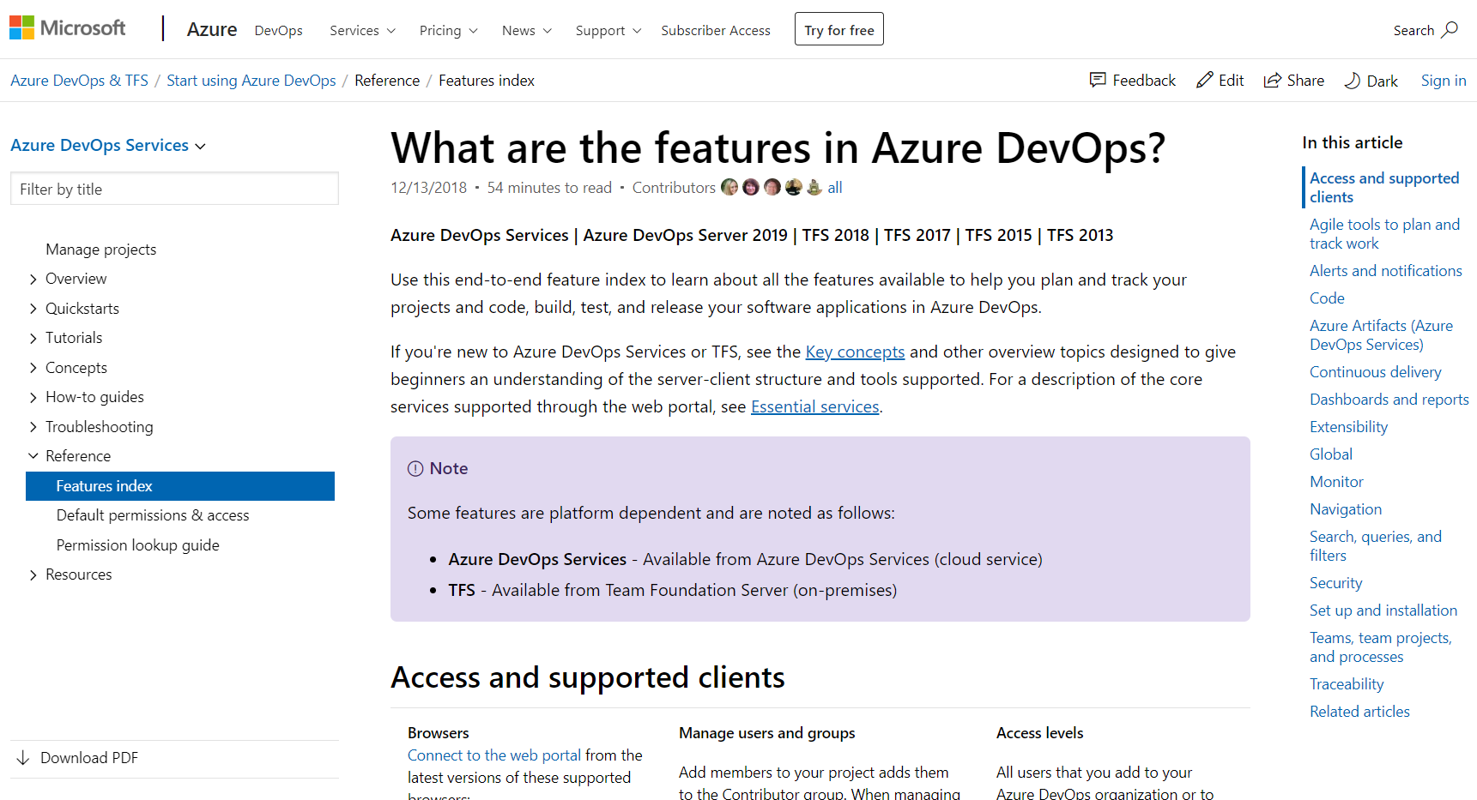
Documentation - Azure DevOps Feature Index
Use this end-to-end feature index to learn about all the features available in Azure DevOps
If you're new to Azure DevOps Services or TFS, see the Key concepts
For a description of the core services supported through the web portal, see Essential services
If you only save one Favorite in your browser related to Azure DevOps, this is the link to save as a favorite!
https://Docs.Microsoft.com/en-us/Azure/DevOps/User-Guide/ALM-DevOps-Features
➔

Slide 13

Thank You!
Please fill out survey
Content: aka.ms/milwaukeedevdays
Survey: aka.ms/ncrdevdayssurvey

Slide 14
